Slide 1
Global BMI Trends in Adults. (1990–2024)
Subject : DAB 422-26W-002 CAPSTONE PROJECT 2
PROFESSOR: DR. Harpreet Virk
PRESENTED BY Group no-04
NATALIA MEJIA ALVAREZ (0872835)
SHALINI SIRDHALA (0875854)
JIE ZHANG (0879447)
PUSHP CHANDRASINH RATHAVA(0867974)

Slide 2

Table of Contents
Project Objective
Data Description
Data Cleaning & Preparation
Exploratory Data Analysis
Proposed Analysis Methods
Machine Learning Modelling
Key Insights
Conclusion

Slide 3

Project Objective
The goal of this project is to analyze global BMI data using machine learning techniques to understand obesity patterns worldwide.
Key objectives include:
Analyze long-term BMI trends over time
Compare BMI across geographic regions
Study BMI differences between male and female populations
Identify BMI risk groups using clustering techniques
Detect unusual BMI observations using anomaly detection
These insights help understand global health risks related to obesity.

Slide 4
Data description
The dataset contains global BMI measurements collected across countries and years.
Important Variables
BMI Value – Estimated BMI measurement
CI Low – Lower confidence interval
CI High – Upper confidence interval
Year – Year of observation
Sex – Male / Female / Both Sexes
Country Code – Country identifier
Region – Geographic region
Indicator – BMI measurement indicator
The analysis focuses on adult BMI indicator (NCD_BMI_25A) for consistency.

Slide 5
Data cleaning & Preparation
Before modelling, the dataset was cleaned and prepared.
Steps performed:
Converted BMI Value, CI Low, CI High, and Year into numeric format
Removed missing or incomplete records
Created a new feature:
CI Range = CI High − CI Low
This feature measures the width of the confidence interval, which indicates the reliability of BMI estimates.
For clustering analysis, the latest available year of data was selected.

Slide 6
Exploratory data analysis
Region | Avg BMI
Americas | ~27.8
Western Pacific | ~27.3
Europe | ~26.8
South-East Asia | ~22.0
Africa | ~20.0
EDA was performed to understand BMIpatterns.
BMI Distribution
Average BMI across the dataset ≈ 24.66
BMI by Sex
Female – Highest average BMI
Both sexes – Medium values
Male – Lowest average BMI

Slide 7

Proposed Analysis Method
Three analytical approaches were used:
1. Clustering Analysis
Identify BMI risk groups
2. Trend Analysis
Examine BMI changes over time
3. Anomaly Detection
Detect unusual BMI observations
These methods help discover hidden patterns in global health data.

Slide 8
Machine Learning Modelling
Three models were applied:
1. K-Means Clustering
Features:
BMI Value
CI Range
Clusters identified:
Low Risk
Medium Risk
High Risk
2. Trend Analysis
Calculated average BMI per year todetect long-term trends.
3. Isolation Forest
Used for anomaly detection.
Parameters:
n estimators = 200
contamination = 0.03
The model detected ~335 anomalousBMI observations.

Slide 9
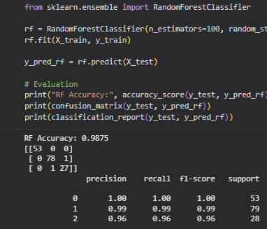
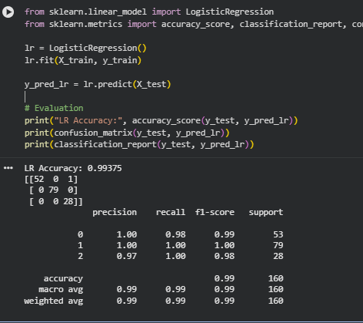
Logistic Regression and Random Forest

Slide 10
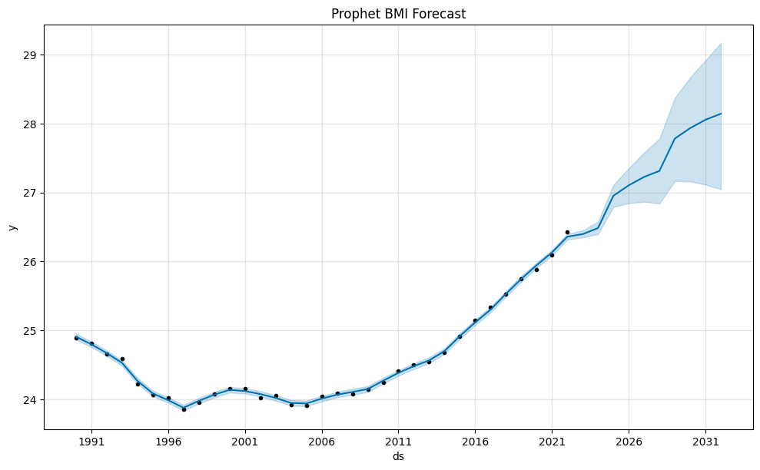
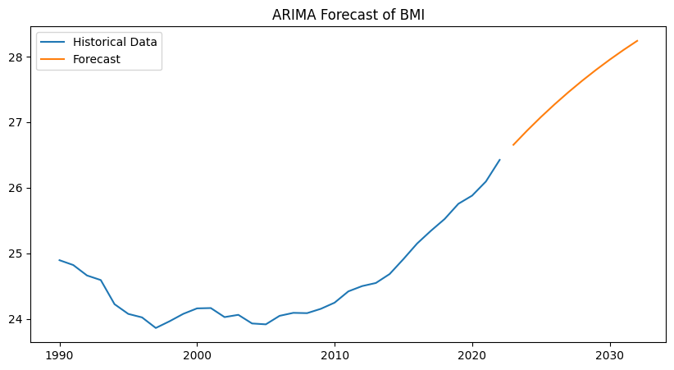
Future predition Model

Slide 11
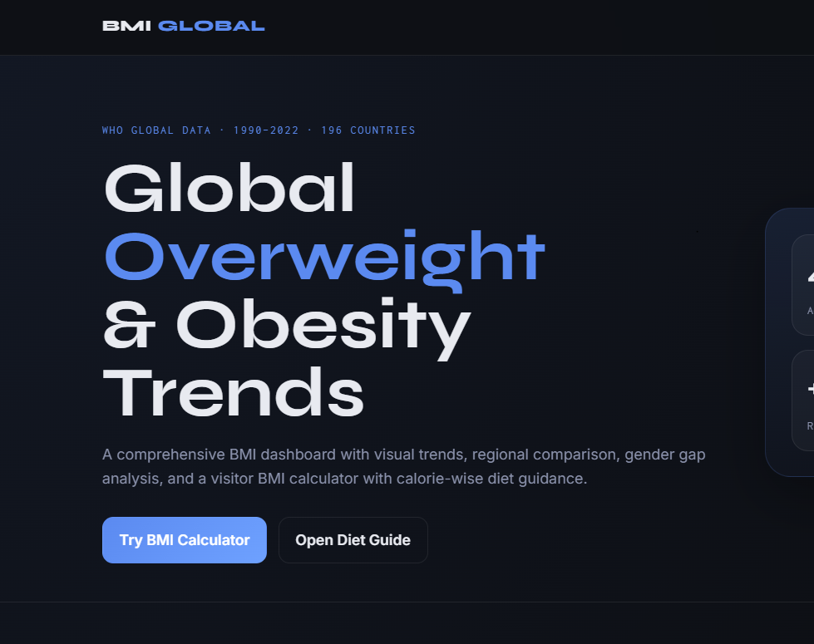
Deployment

Slide 12

BMI Calculator

Slide 13

Key Insights
Global BMI shows a consistent upward trend over time, indicating increasing obesity risk worldwide
Americas and Western Pacific regions have the highest average BMI, highlighting regional disparities
K-Means clustering successfully identified three meaningful BMI risk groups (Low, Medium, High)
Isolation Forest detected ~335 anomalies, with Africa showing the highest variability in BMI patterns
Supervised models (Logistic Regression & Random Forest) confirmed BMI as a strong predictor of overweight classification
Random Forest outperformed Logistic Regression, achieving higher accuracy and better predictive performance
Forecasting models (Prophet and ARIMA) predict a continued rise in global BMI in future years
Consistency across clustering, classification, and forecasting models strengthens the reliability of results

Slide 14

Conclusion
This project demonstrates how a combination of machine learning and forecasting techniques can effectively analyze and predict global BMI trends.
Unsupervised methods (K-Means and Isolation Forest) revealed hidden patterns, risk groups, and anomalies in BMI data
Trend analysis confirmed a steady global increase in BMI over time
Supervised models (Logistic Regression and Random Forest) validated BMI as a strong predictor of overweight classification, with Random Forest achieving the highest performance
Forecasting models (Prophet and ARIMA) projected a continued rise in BMI, highlighting future global health risks
Overall, the integration of unsupervised learning, supervised learning, and time-series forecasting provides a comprehensive and reliable framework for understanding and predicting obesity trends. These insights can support data-driven decision-making in public health planning and policy development.

Slide 15

Thank You

